Slide 1




Synaptic Theory of Working Memory
AIBC2021
Aohua Cheng
Tsinghua University

Slide 2

Self-Introduction
Aohua Cheng
Lab1 : Medicine & Medical Robot Research Center
Lab2 : Sunpei/Tyanyang Lab
Research background :
Medical Robot, Computational neuromorphology,
Memory recall
Interest:
Consciousness, Biophysics, ANN
Swimming, Tennis

Slide 3
Project background and the scientific question
• Working Memory: Temporary information for processing purposes, playing a crucial role in cognitive tasks. Delayed-response paradigm
• Background Survey: emerge from intrinsic cell properties or as persistent reverberations in selective neural populations coding for different memories
• What is the carrier of working memory?
Authors proposed that an item is maintained in the WM state by short-term synaptic facilitation mediated by increased residual calcium levels at the presynaptic terminals of the neurons that code for this item
Synapse Theory of Working Memory G Mongillo, O Barak, M Tsodyks - Science, 2008

Slide 4

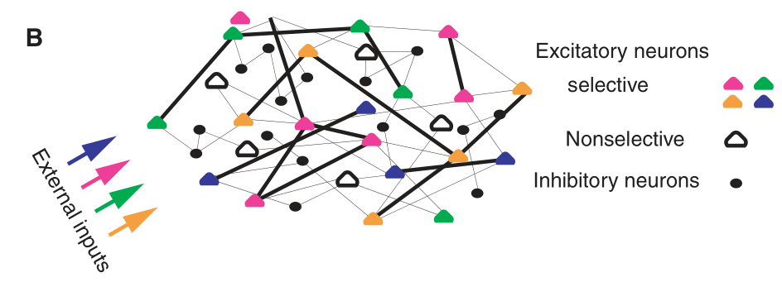

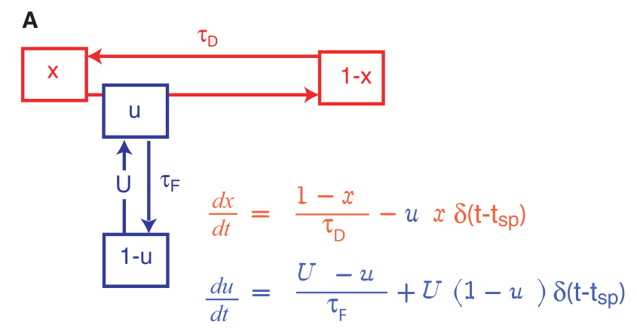
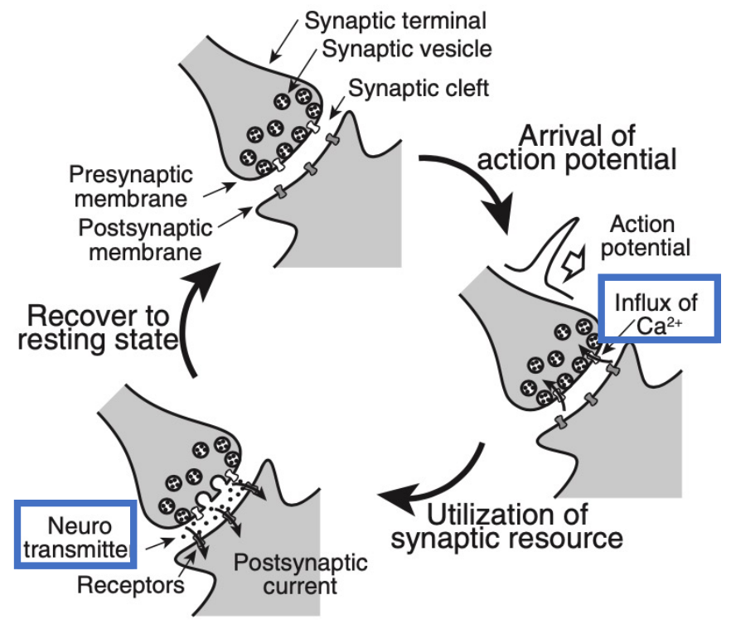


Method
Neuron : LIF model
Network: specific connectivity
Synapse: Short Term Potential

Slide 5
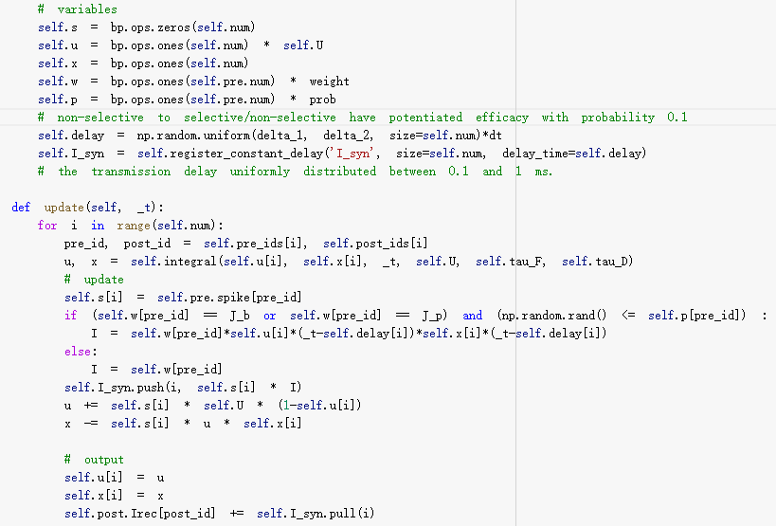
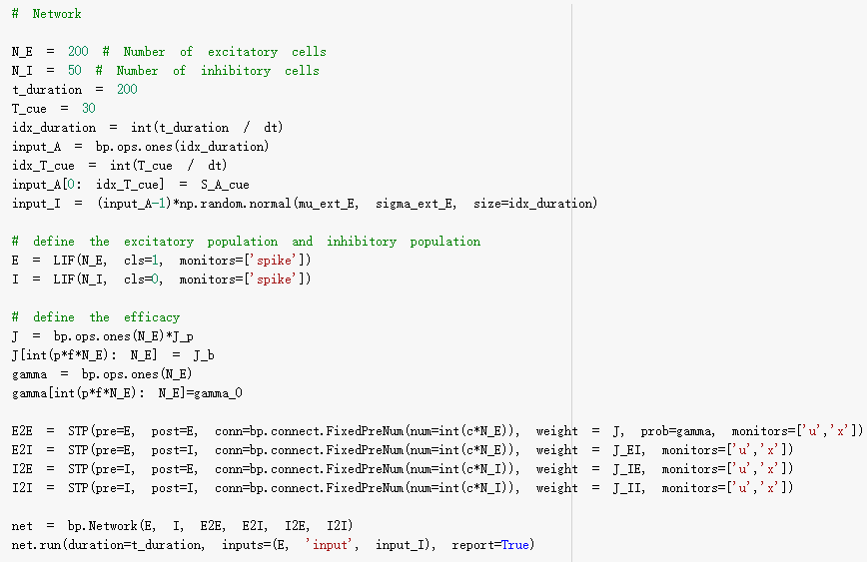
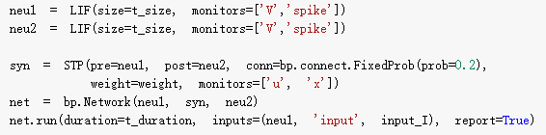
Method
STP class
Network class
One-item coding

Slide 6
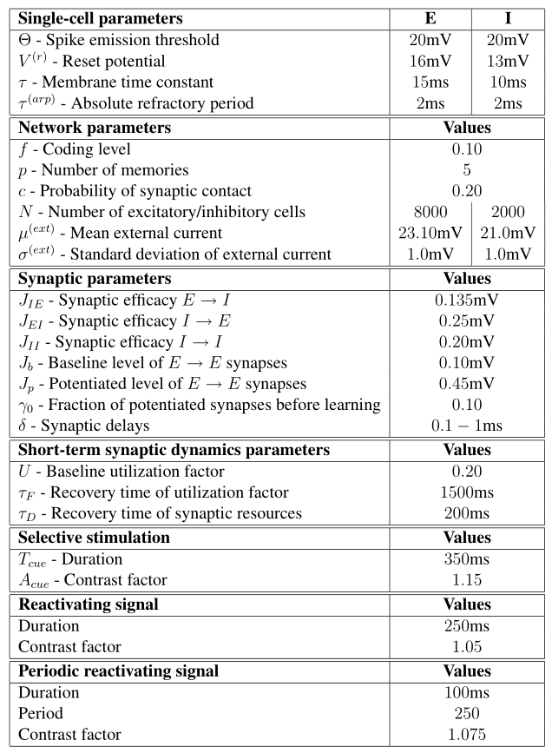
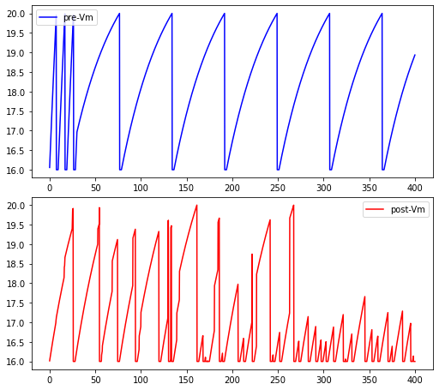
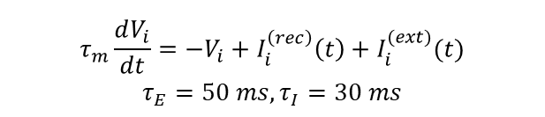
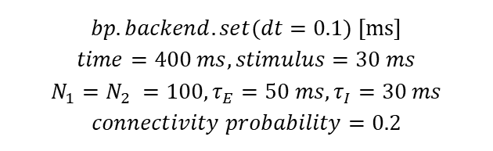
Results
$$τ_{m}\frac{dV_{i}}{dt}=−V_{i}+I_{i}^{\left(rec\right)}\left(t\right)+I_{i}^{(ext)}(t)$$
$$τ_{E}=50 ms, τ_{I}=30 ms$$
Parameters setting
2-group 1-stimulus simulation(E2E)
$$bp.backend.set(dt=0.1\text{) [}\text{ms}\text{]}$$
$$time=400 ms, stimulus=30 ms$$
$$N_{1}=N_{2} =100, τ_{E}=50 ms, τ_{I}=30 ms$$
$$connectivity probability=0.2$$

Slide 7
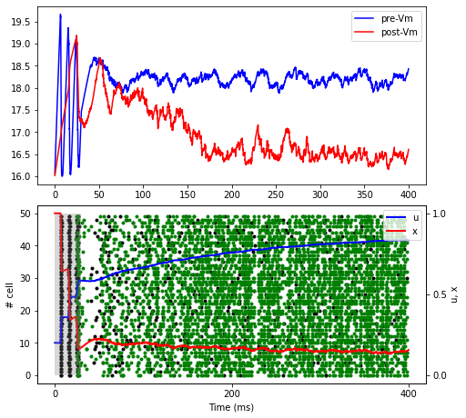
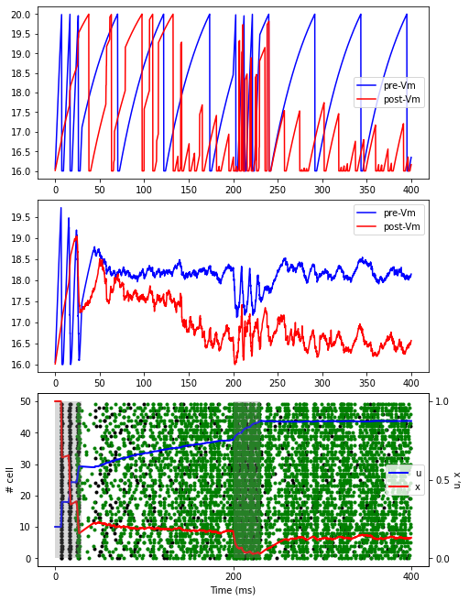
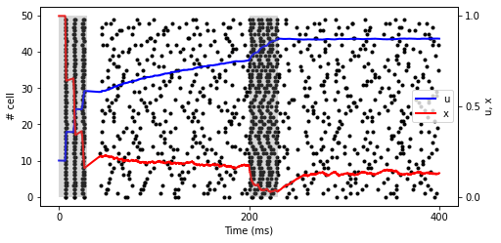
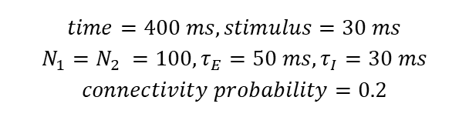
Results
$$time=400 ms, stimulus=30 ms$$
$$N_{1}=N_{2} =100, τ_{E}=50 ms, τ_{I}=30 ms$$
$$connectivity probability=0.2$$
2-group 1-stimulus stimulation(E2E)
2-group 2-stimulus simulation(E2E)

Slide 8
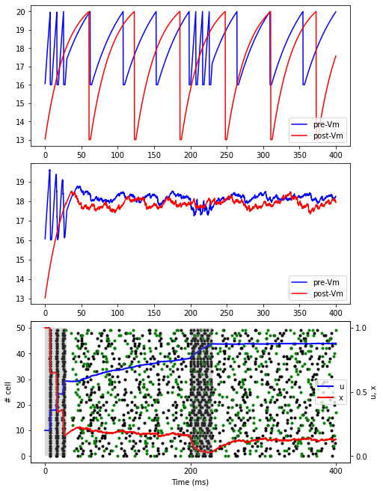
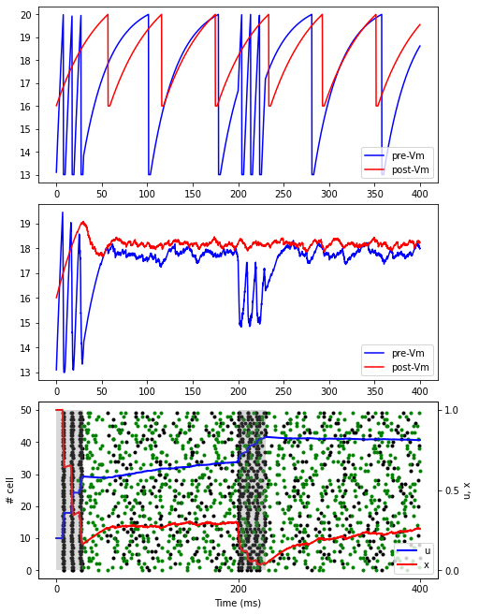
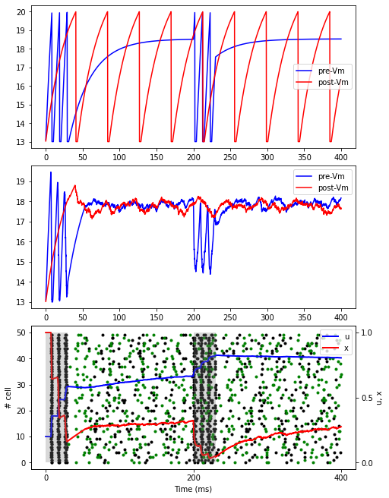
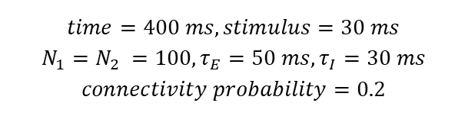
Results
$$time=400 ms, stimulus=30 ms$$
$$N_{1}=N_{2} =100, τ_{E}=50 ms, τ_{I}=30 ms$$
$$connectivity probability=0.2$$
2-group 2-stimulus stimulation(E2I)
2-group 2-stimulus simulation(I2E)
2-group 2-stimulus simulation(I2I)

Slide 9
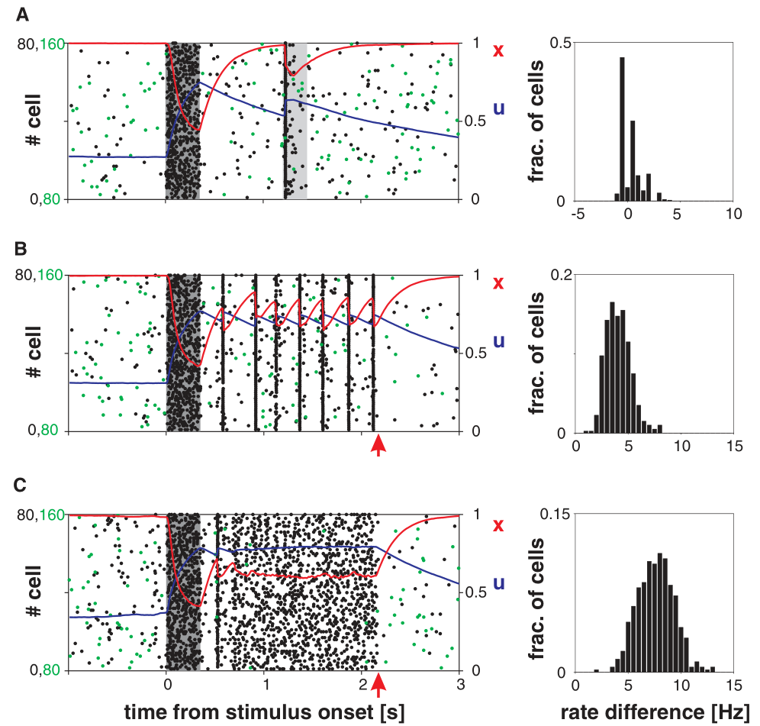
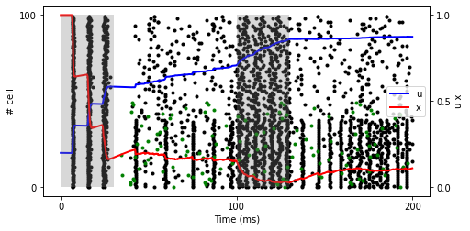
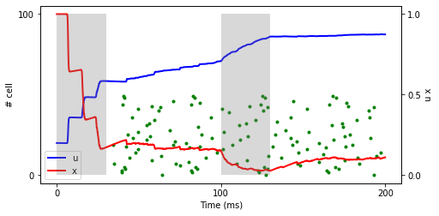
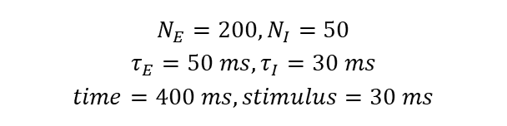
Results
$$N_{E}=200, N_{I}=50$$
$$τ_{E}=50 ms, τ_{I}=30 ms$$
$$time=400 ms, stimulus=30 ms$$
One-item Network stimulation

Slide 10
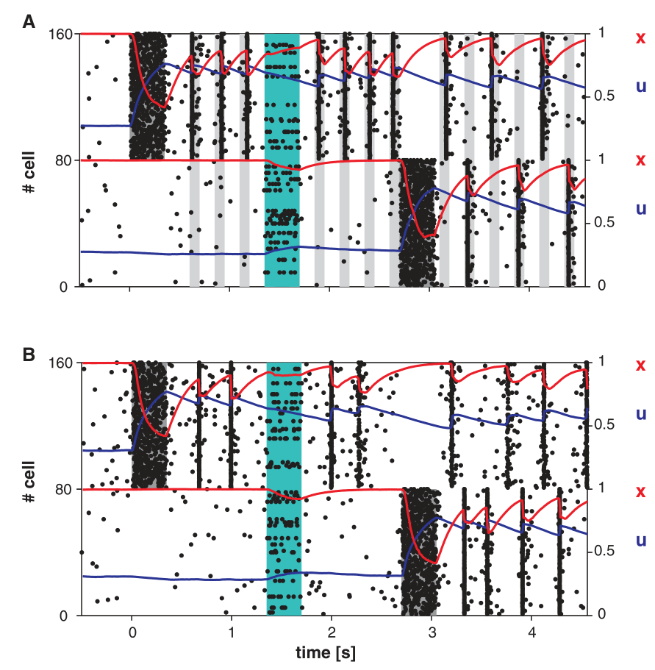
Results
Two-item Network stimulation
Robustness to noise and two-item memory. The first item is loaded into memory at t = 0 (dark shading). The second item is loaded into memory at t = 2.7 s. Teal shading indicates a random nonspecific input to 15% of the excitatory neurons. (A) Periodic sequence of nonspecific external inputs is used to refresh the memory (gray shading). (B) Persistent PSs. Dots, rasters of 10% of the first (0 to 79) and second (80 to 159) populations' neurons; red and blue curves, same
as in Fig. 2.

Slide 11
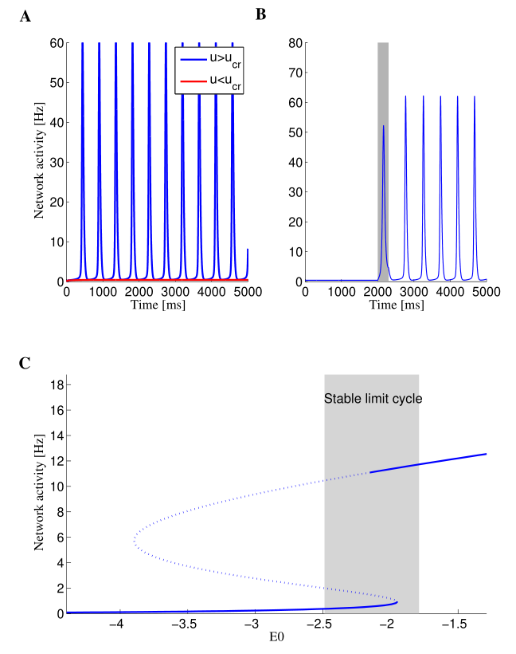
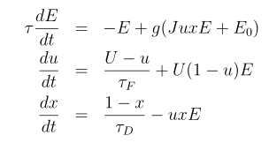

Discussion-Bifurcation
A B bistable: steady state / a limit cycle solution
$$τ_{m}\frac{dV_{i}}{dt}=−V_{i}+I_{i}^{\left(rec\right)}\left(t\right)+I_{i}^{(ext)}(t)$$
Bifurcation diagram showing E as a function of E0. Solid and dashed lines mark stable and unstable steady states respectively. The shaded area denotes the range of external input with a stable limit cycle solution.

Slide 12
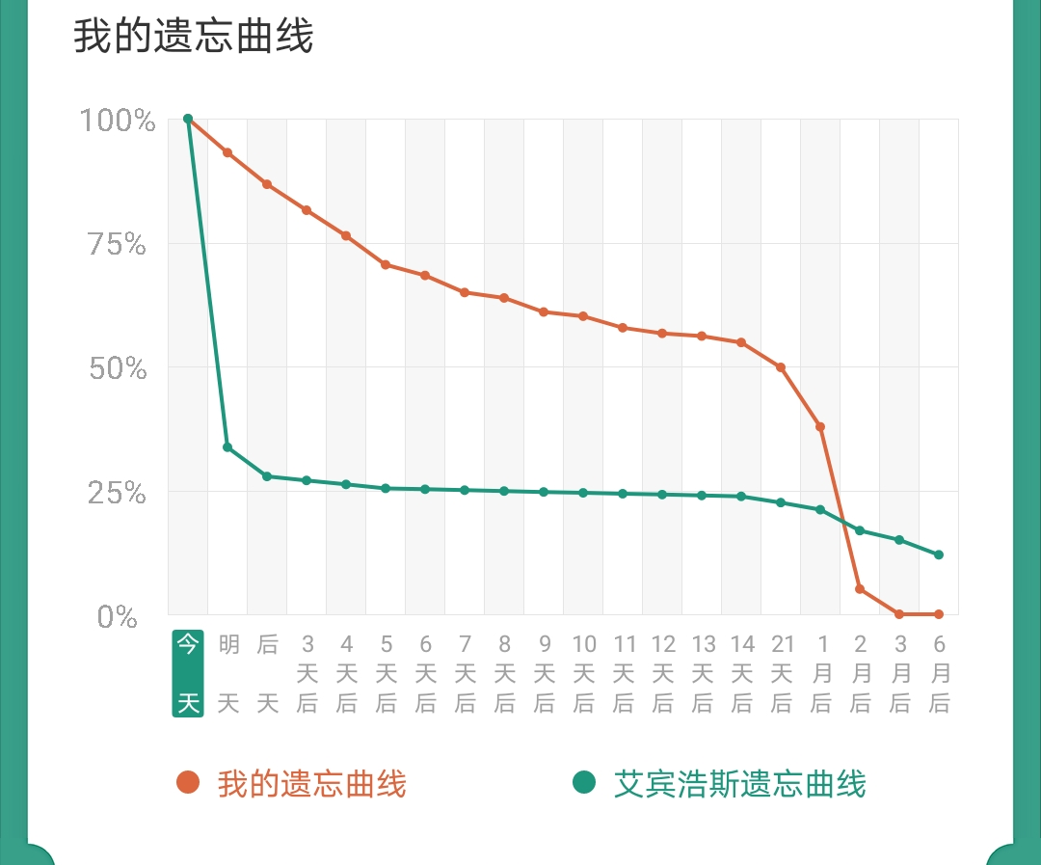
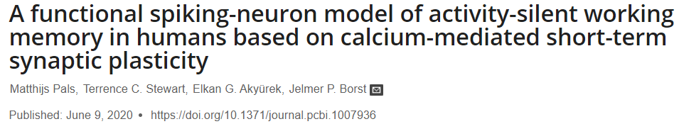
Discussion
• Do I understand this paper correctly? Is calcium levels really a good explanation for memory recall in PFC?
• Bifurcation analysis and more parameter tunning
• Neuromorphology, Memory recall (The Ebbinghaus Forgetting Curve) by brainpy

Slide 13
Acknowledgment
Thank Chaoming Wang, Zilong Ji, XiaoLiu’s help for tutorials and the project.
Thank Professors for exciting lectures to broaden our horizon of CN and AI.
Thank Prof. Si Wu, Jun Zhang .etc for organizing such a wonderful summer school.
Thank peers for discussing and having a good time in CSHA.

Slide 14
Q & A ～5 mins
AI and Brain Computation
August 9 - August 22, 2021

Slide 15
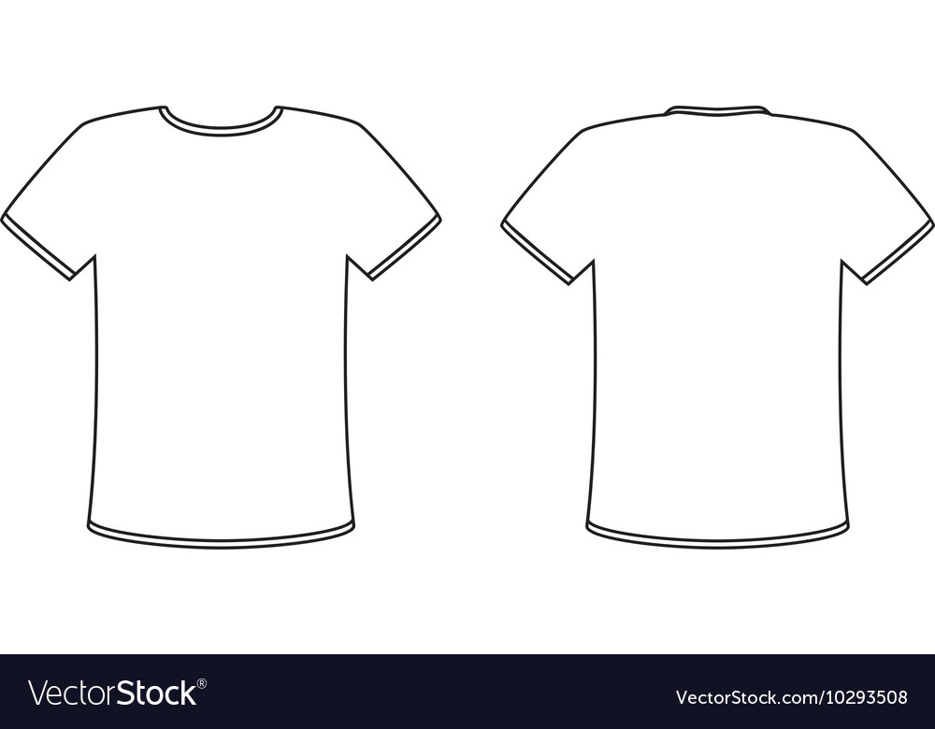
Your T-shirt Design
Memory for our AIBC2021～
Don‘t Quit！
Tips：
1，可以体现AI和Brain Computing的交叉
2，可以体现2021的元素（今年是我们第一届summer school，是元年）
3，可以体现online课程的特殊性
4，可以体现你对AIBC2021的感受
5，...

